Slide 1
IBM Cloud Workshop Hochschule Reutlingen — Martin Henke Marc Schwind Enrico Regge Michael Schäfer

Slide 2
Why Cloud ???

Slide 3
Thought Experiment No Cloud !!

Slide 4



Datacenter
Network
Air Condition
Server
Server
Your Cool App
Your Data
Node JS Server
MySQL
OS
OS
Power
Notes:
- Security update needed for Servers and OS
- Care for hardware problems - Care for reliable network
- Power and Cooling needed - Datacenter
- Access control

Slide 5
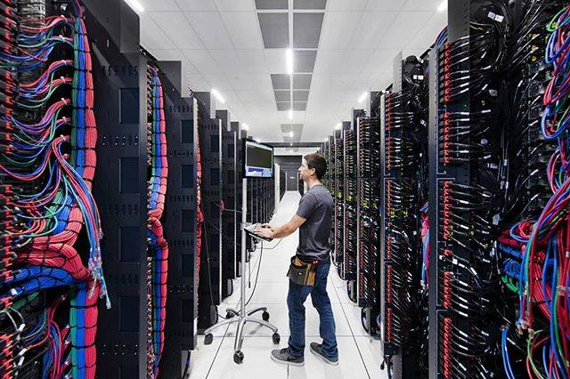

Slide 6
Back to Reality

Slide 7
IaaS Infrastructure as a Service

Slide 8
Datacenter
Network
Air Condition
Server
Server
Your Cool App
Your Data
Node JS Server
MySQL
OS
OS
Power
Notes:
- Place your Server in Datacenter - Colocation
- Use real or virtual Servers
- Use provided OS images

Slide 9
PaaS Platform as a Service
SaaS System as a Service

Slide 10
Your Cool App
Your Data
Node JS Server
MySQL
Notes:
Use PaaS platfor to avoid Server maintainence
Use SaaS offering to use only interfaces to get capabilities

Slide 11
One more Thing

Slide 12
FaaS (aka Serverless)

Slide 13
function main(params) { return { message: 'Hello World' }; }

Slide 14
Exposed via API or started by Event No cost when not invoked Scales automatically Sequences to combine actions

Slide 15
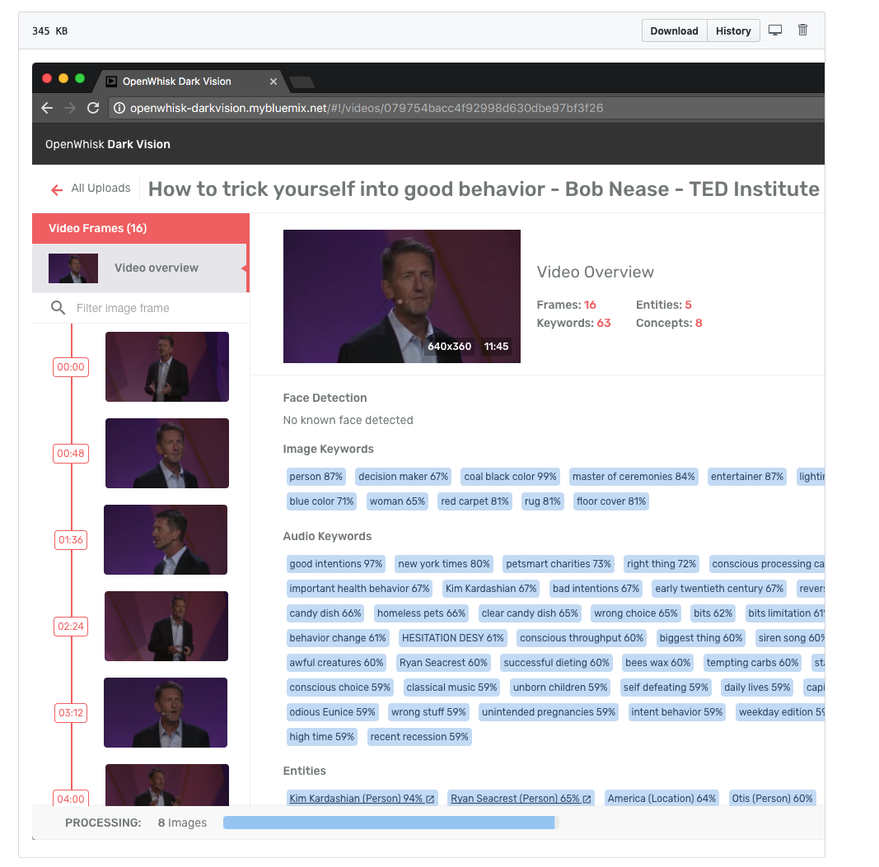

Slide 16
Why Cloud ???
Speed to Market
Scale
Money

Slide 17
Demo Platforms & Service Catalog

Slide 18
How ???

Slide 19
Microservices

Slide 20
Monolith to Microservices - Example
Monolith
Microservice Based
Application
Orders service
DB
Storefront UI
Run-time
Orders
service
Storefront UI
Shipping service
DB
Proxy
DB
Shipping service
Run-time
Run-time
Catalog
service
Catalog service
DB
Run-time
Middleware

Slide 21
Source Control

Slide 22
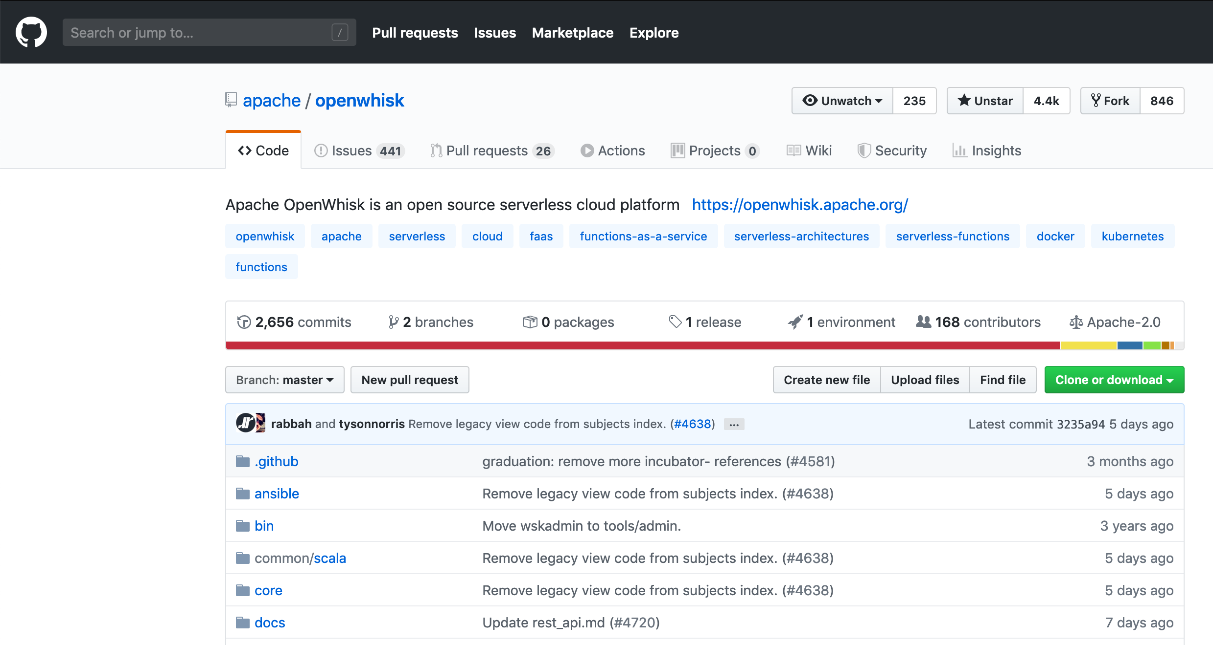
Everything is in the Source Repo

Slide 23
CI/CD
Continous Integration
Continous Deployment
(Continous Testing)

Slide 24
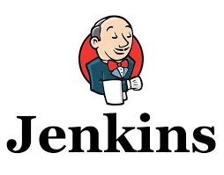


Everything is automated

Slide 25
Open Platforms Community Proven

Slide 26
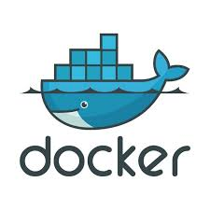


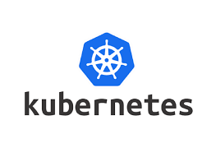

Slide 27
Questions

Slide 28
IBM sign-off

